Slide 1
Effects of Osmosis on Water Balance
Osmosis is the diffusion of water across a selectively permeable membrane
The direction of osmosis is determined only by a difference in total solute concentration
Water diffuses across a membrane from the region of lower solute concentration to the region of higher solute concentration

Slide 2
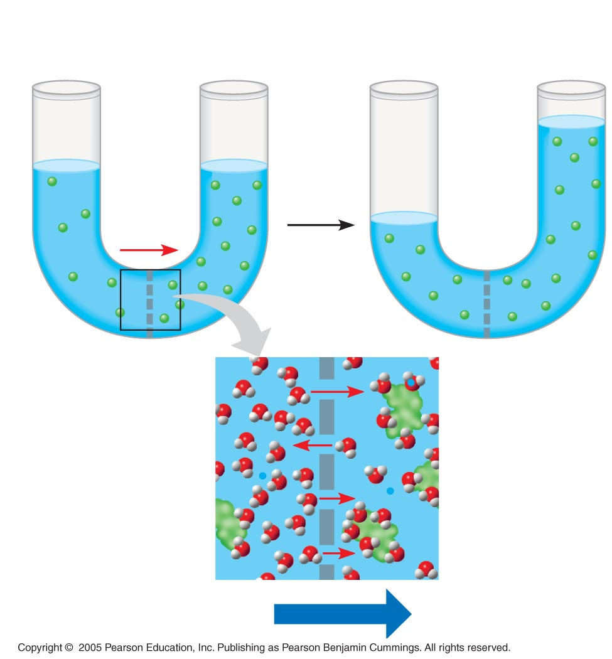
Lower
concentration
of solute (sugar)
Higher
concentration
of sugar
Same concentration
of sugar
H₂O
Selectively
permeable mem-
brane: sugar mole-
cules cannot pass
through pores, but
water molecules can
Osmosis

Slide 3
Water Balance of Cells Without Walls
Tonicity is the ability of a solution to cause a cell to gain or lose water
Isotonic solution: solute concentration is the same as that inside the cell; no net water movement across the plasma membrane
Hypertonic solution: solute concentration is greater than that inside the cell; cell loses water
Hypotonic solution: solute concentration is less than that inside the cell; cell gains water

Slide 4
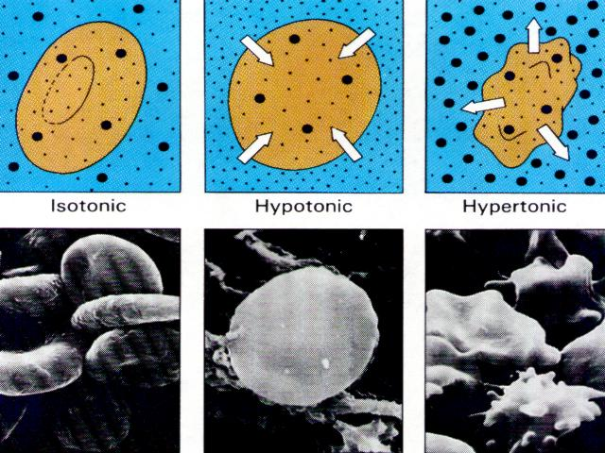

Slide 5
Animals and other organisms without rigid cell walls have osmotic problems in either a hypertonic or hypotonic environment
To maintain their internal environment, such organisms must have adaptations for osmoregulation, the control of water balance
The protist Paramecium, which is hypertonic to its pond water environment, has a contractile vacuole that acts as a pump

Slide 6
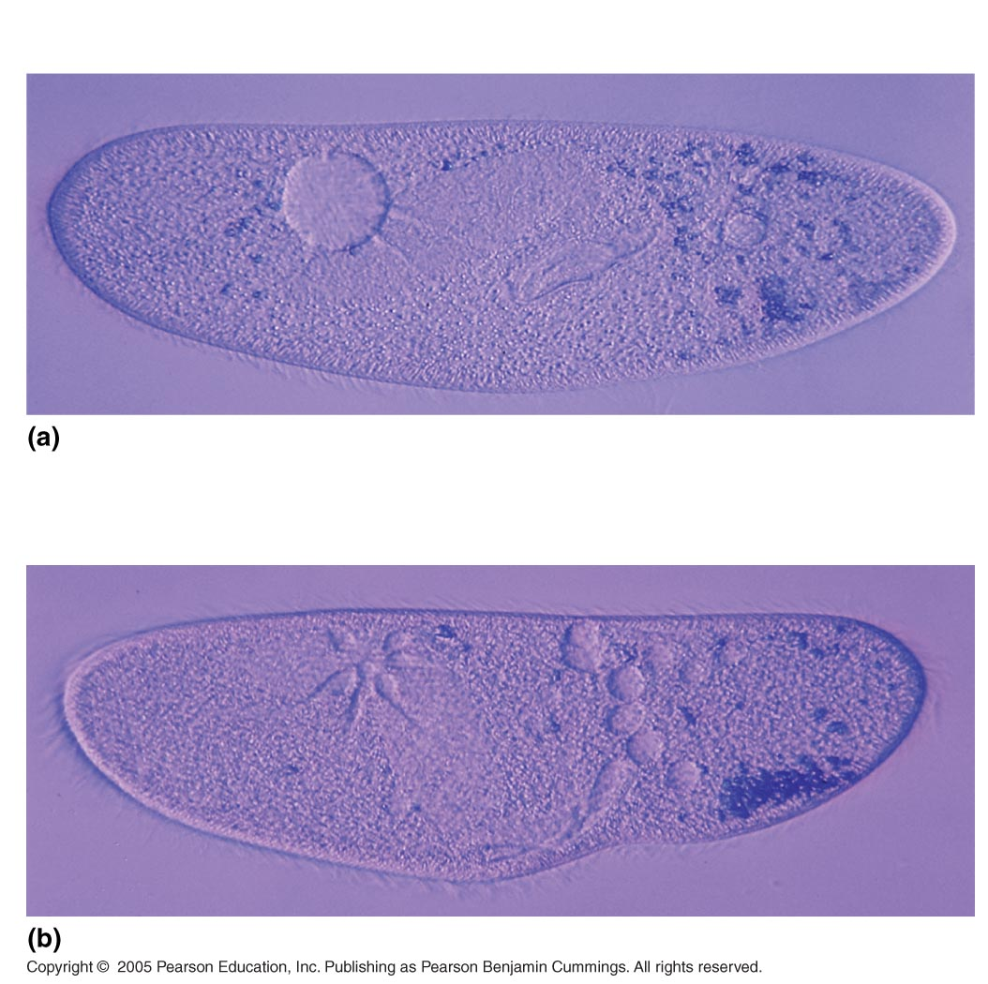
50 µm
Filling vacuole
50 µm
Contracting vacuole

Slide 7
Water Balance of Cells with Walls
Cell walls help maintain water balance
A plant cell in a hypotonic solution swells until the wall opposes uptake; the cell is now turgid (firm)
If a plant cell and its surroundings are isotonic, there is no net movement of water into the cell; the cell becomes flaccid (limp), and the plant may wilt
In a hypertonic environment, plant cells lose water; eventually, the membrane pulls away from the wall, a usually lethal effect called plasmolysis

Slide 8
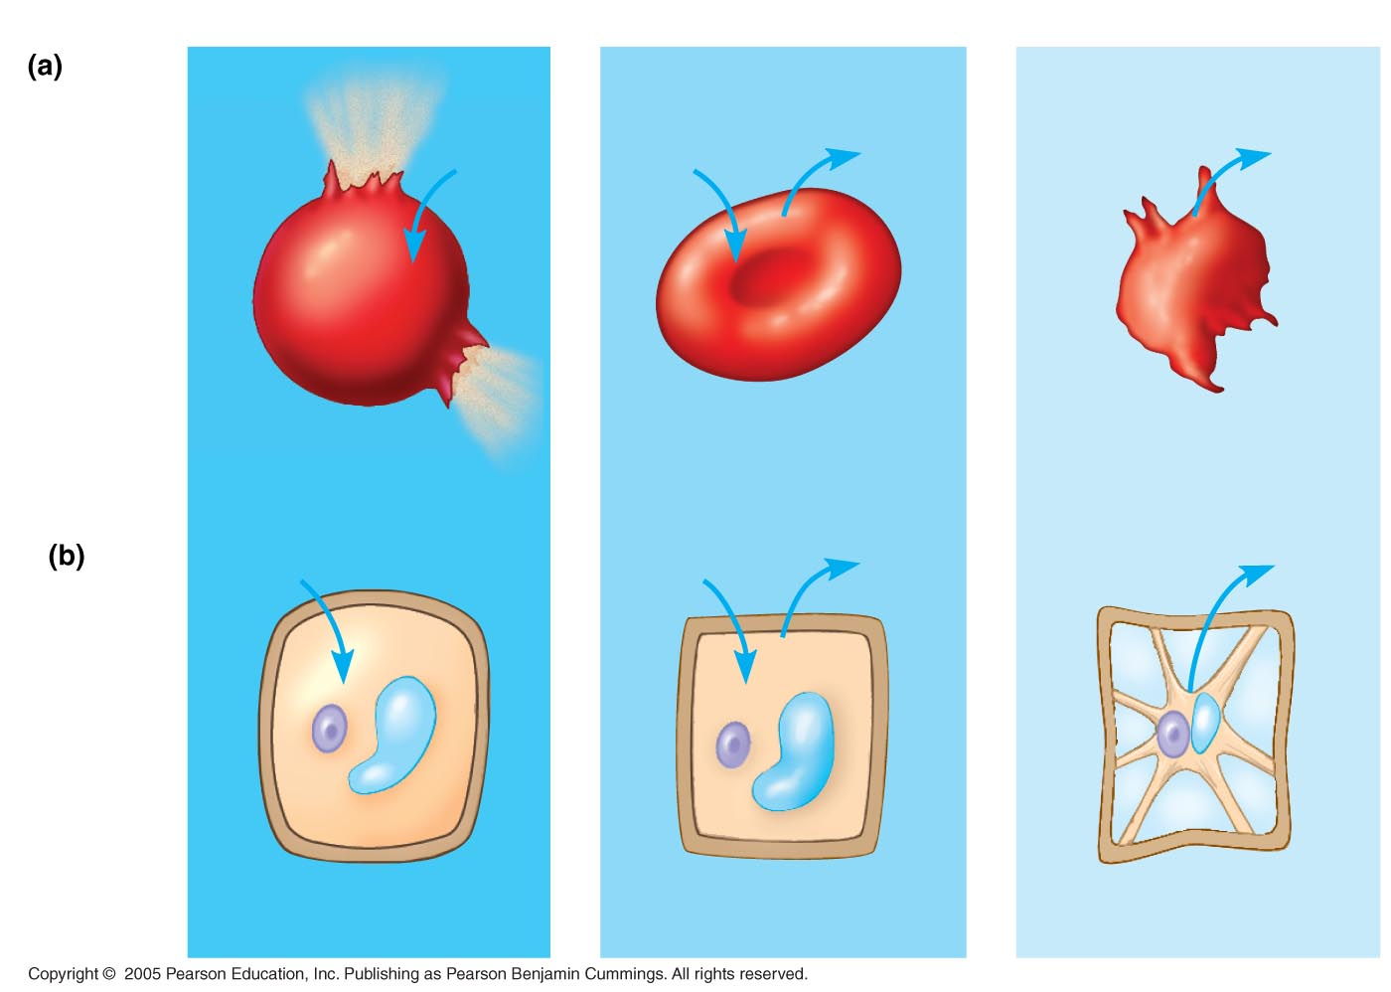
Hypotonic solution
Isotonic solution
Hypertonic solution
Animal
cell
H₂O
H₂O
H₂O
H₂O
Lysed
Normal
Shriveled
Plant
cell
H₂O
H₂O
H₂O
H₂O
Turgid (normal)
Flaccid
Plasmolyzed

