Slide 1
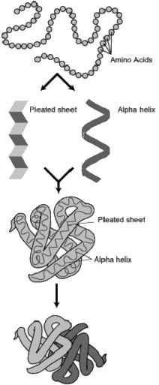
Biology/Chemistry of Protein Structure
Primary
Secondary
Tertiary
Quaternary
Assembly
Folding
Packing
Interaction
S T R U C T U R E
P R O C E S S

Slide 2
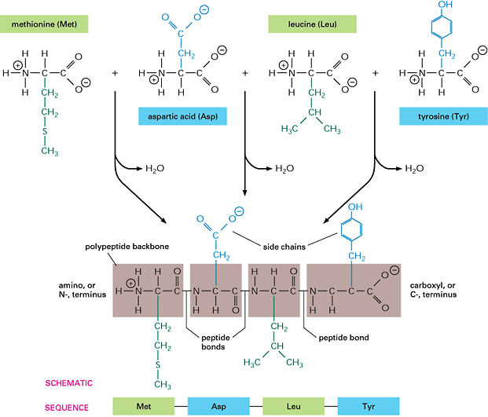
Protein Assembly
occurs at the ribosome
involves dehydration synthesis and polymerization of amino acids attached to tRNA:
NH - {A + B → A-B + H O} -COO
thermodynamically unfavorable, with ΔE = +10kJ/mol, thus coupled to reactions that act as sources of free energy
yields primary structure
+
-
3
2
n

Slide 3
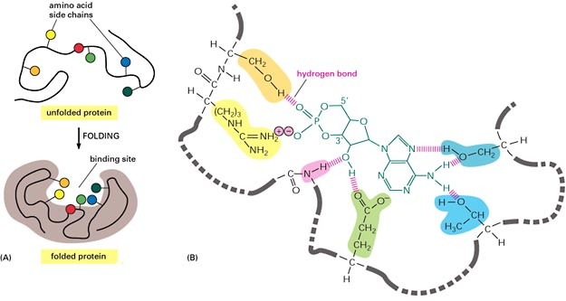
Protein Folding - Secondary
occurs in the cytosol
involves localized spatial interaction among primary structure elements, i.e. the amino acids
may or may not involve chaperone proteins
formed and stabilized by hydrogen bonding, electrostatic and van der Waals interactions

Slide 4
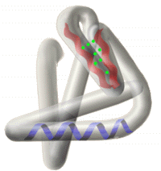
Tertiary Structure
non-linear
3 dimensional
formed and stabilized by hydrogen bonding, covalent (e.g. disulfide) bonding, hydrophobic packing toward core and hydrophilic exposure to solvent
A globular amino acid polymer folded and compacted is somewhat functional (catalytic) and energetically favorable → interaction!

Slide 5
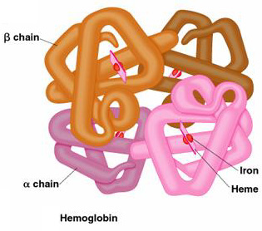
Quaternary Structure
non-linear, 3 dimensional
Occurs in cytosol
formed by hydrogen bonding, covalent bonding, hydrophobic packing and hydrophilic exposure
involves interaction among tertiary structure elements of separate polymer chains

