Slide 1
LIPIDS

Slide 2
Characteristics of Lipids
Composed of Carbon, Hydrogen, and Oxygen
Greater than 2:1 ratio of H:O
Includes fats, oils, phospholipids, and cholesterol
Building blocks are fatty acids and glycerol.
Energy storage molecules

Slide 3
Fatty Acid Structure
Carboxyl group (COOH) forms the acid.
“R” group is a hydrocarbon chain.

Slide 4
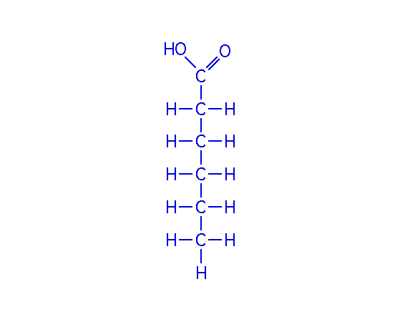
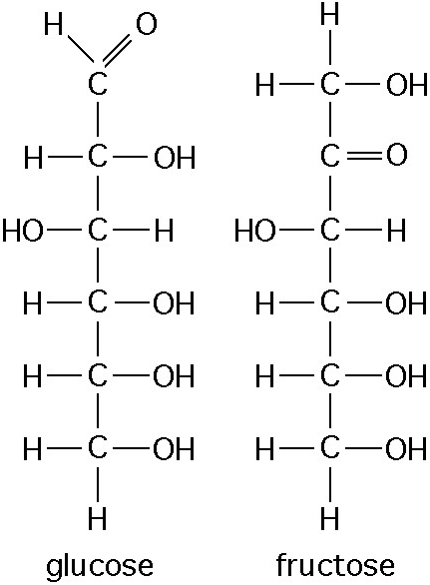
A Representative Fatty Acid

Slide 5
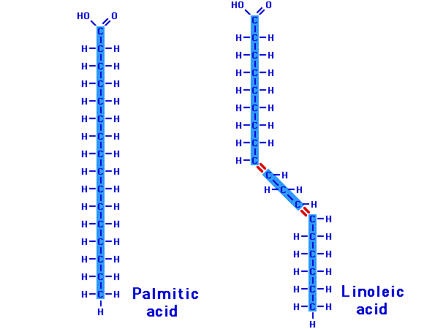
Unsaturated
Fatty Acid
Saturated
Fatty Acid

Slide 6
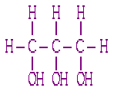
Glycerol

Slide 7
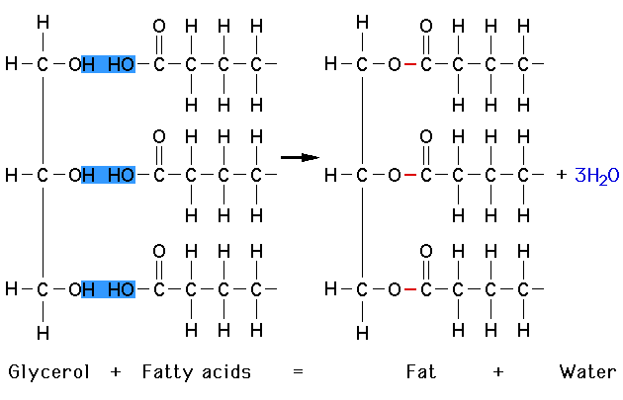
Synthesis of a Fat
Dehydration synthesis

Slide 8
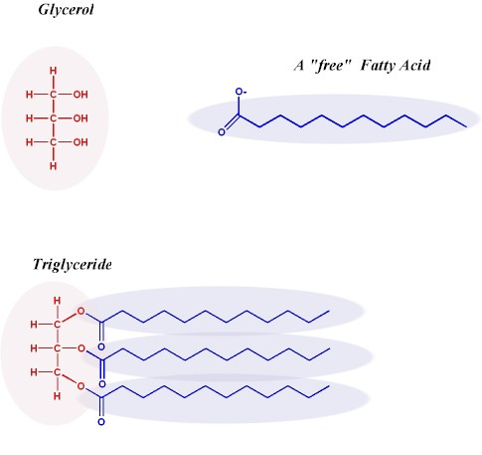

Slide 9
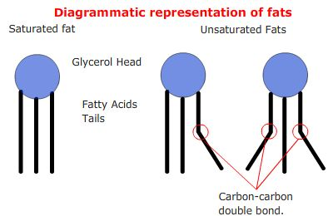

Slide 11
For a very detailed read on just how we eat, store and use our food see:
http://science.howstuffworks.com/life/cellular-microscopic/fat-cell3.htm

