Slide 1
Why Should We Care About Plants?

Slide 2
Why Should We Care About Plants?
Food source
Provide oxygen
Foundation of the food chain
Water (plants help regulate the water cycle and purify water bodies)

Slide 3
Why Should We Care About Plants?
Habitat
Medicine
Resources (clothes, homes, etc.)
Provide enjoyment and beauty

Slide 4
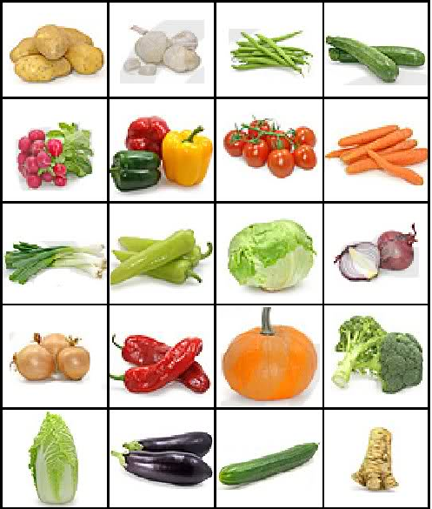

Slide 5
Vegetables
https://www.youtube.com/watch?v=bGYs4KS_djg

Slide 6
Plants are cool!
http://www.youtube.com/watch?v=mooMo5k2w50

Slide 7
Plants can also be deadly!
http://www.youtube.com/watch?v=RmzbQsIdaFw

Slide 8
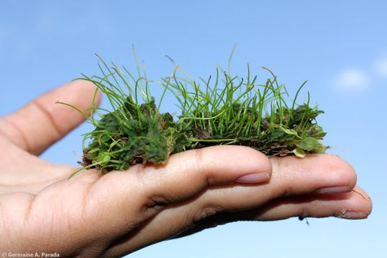
Brainstorm:
How do we characterize plants?
In other words, what are their distinguishing features?

Slide 9
WHAT CHARACTERISTICS COME TO MIND WHEN YOU THINK OF PLANTS?
TWO distinct characteristics of most flowering plants, ferns, conifers are:
GREEN COLOUR (Due to CHLOROPHYLL for Photosynthesis)
Can not move from place to place (ROOTS anchor them in place)

Slide 10
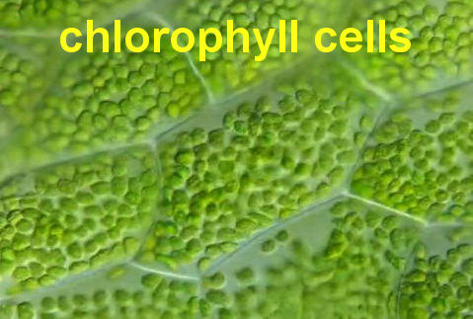
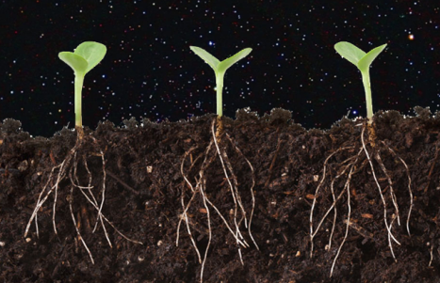
WHAT CHARACTERISTICS COME TO MIND WHEN YOU THINK OF PLANTS?
These TWO characteristics have a great influence on the overall structure and functions of the plant.

Slide 11
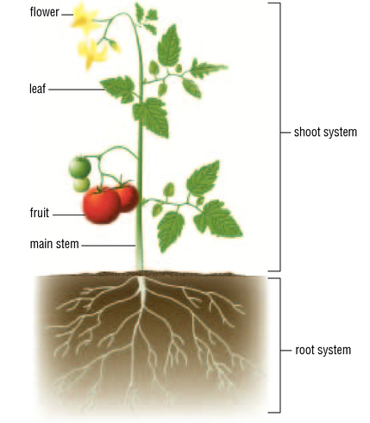
Two Main Body Systems Roots and Shoots!
Shoot system
Consists of the stem,
leaves, and flowers
Root system
Made up of separate roots

Slide 12
HIERARCHY OF PLANT BODY
SHOOT SYSTEM
system in flowering plant that is specialized to
conduct food and water
photosynthesize
reproduce sexually
consists of leaf, flower, and the stem

Slide 20
HIERARCHY OF PLANT BODY
ROOT SYSTEM
anchors the plant
absorbs water and minerals through tiny root hairs
conducts water and nutrients
stores food and nutrients

Slide 21
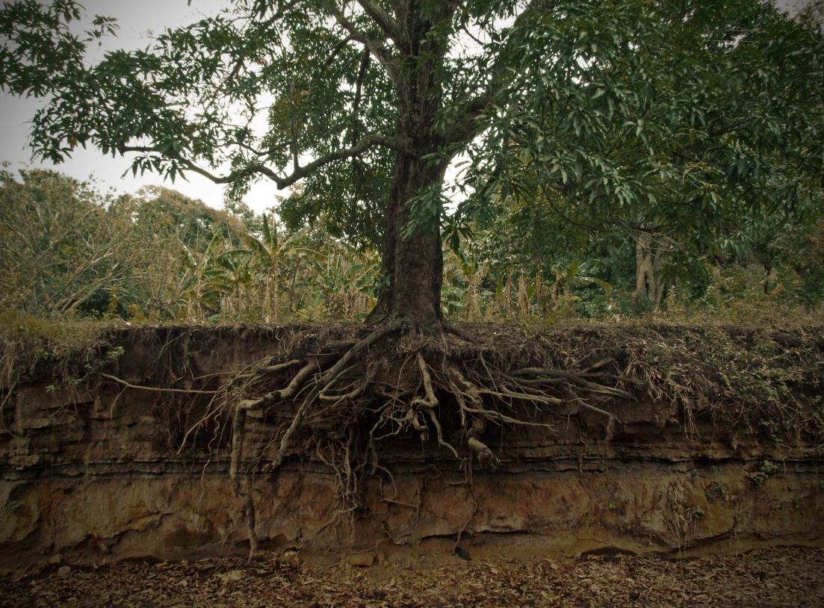
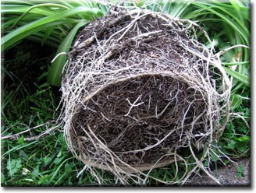
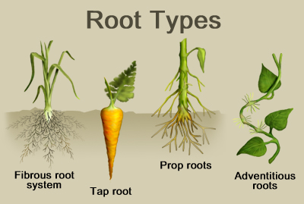

Slide 23
HIERARCHY OF PLANT BODY
Roots, leafs, flower, and stems are considered the ORGANS of the plant or more simply PLANT PARTS made of SPECIALIZED CELLS.
PLANT TISSUES are considered as separate systems.

Slide 24
Important Functions of Plants:
Plants need to exchange gases with their surroundings
Plants require an internal transportation system to move water and nutrients around within their bodies
Plants need to have a way to reproduce

Slide 25
The Leaf & Photosynthesis
Because plants make their own food, they DON’T need:
to move in search of food or have complex systems like us (digestive, nervous, etc)
Plants DO need:
To exchange gases with their surroundings
An internal transport system for water and nutrients
A reproductive system

Slide 26
The Leaf
Photosynthesis
The Leaf is the main photosynthetic structure of plant
– organelle called CHLOROPLAST (only in Plant Cells) actually performs photosynthesis
Photosynthesis is:
chlorophyll
light energy + carbon dioxide + water glucose + oxygen

Slide 27
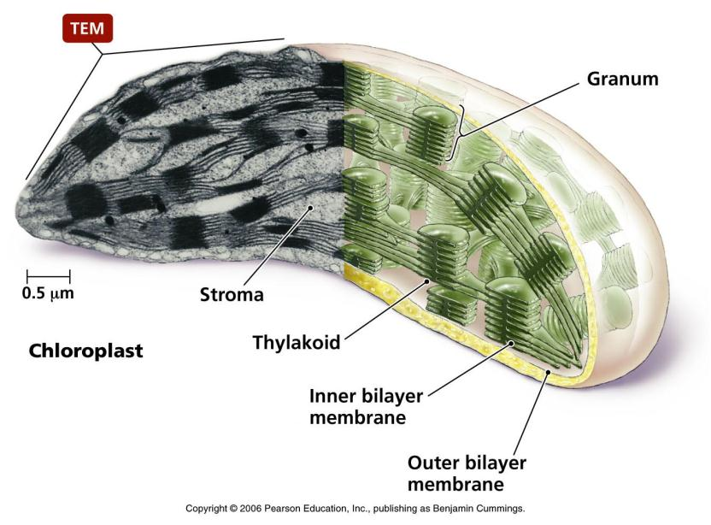

Slide 28
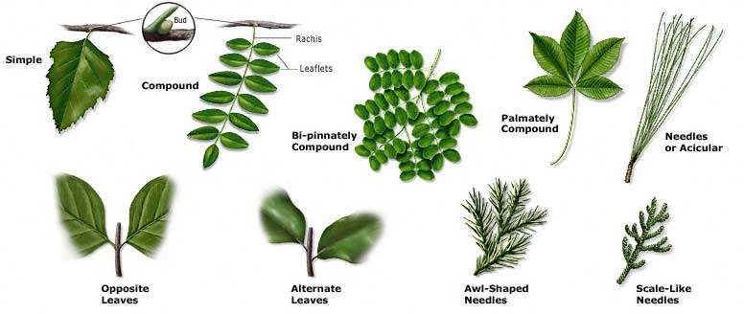
Leaves can be adapted for support, protection, reproduction and attraction
Leaves can be adapted for support, protection, reproduction and attraction

Slide 29
CLOSER LOOK AT THE LEAF

Slide 30
Flower
– specialized structures developed for sexual reproduction
– MALE reproductive structure
- produce pollen grains
– FEMALE reproductive structure
- produce eggs
- contains structures, or sometimes both

Slide 31
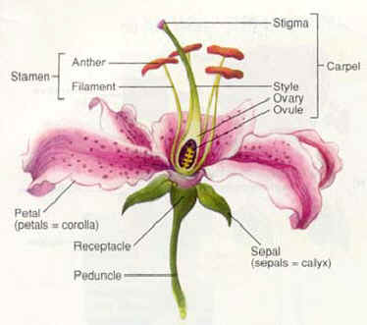

Slide 32
Pollination
– POLLINATION is the act of the eggs being fertilized by pollen
after POLLINATION, female flower parts form seeds that in most flowering plants are contained in specialized structures called FRUIT
– POLLINATION occurs due to the help of wind or animals like birds, bats, insects

Slide 33
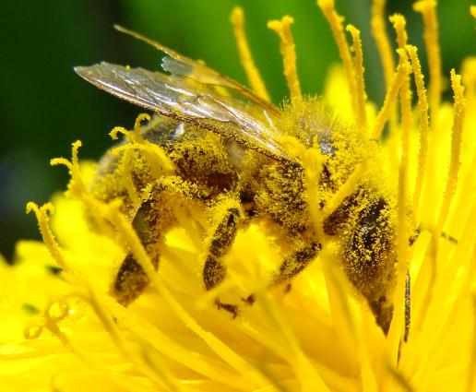
Pollination

Slide 34
The Beauty of Pollination
Orchid imitating a female bee
http://www.youtube.com/watch?v=-h8I3cqpgnA

Slide 35
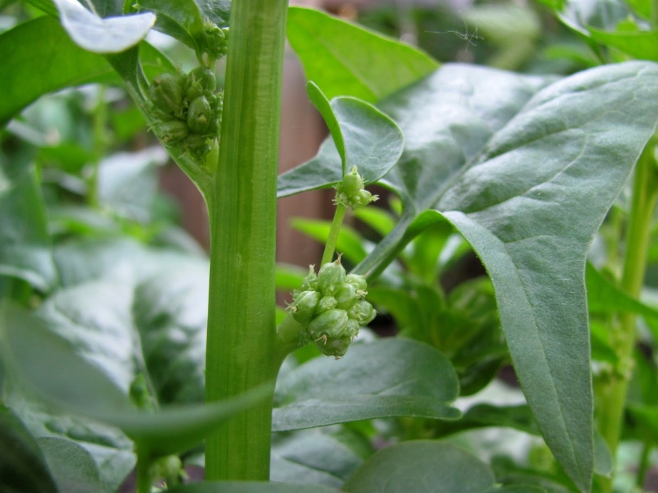
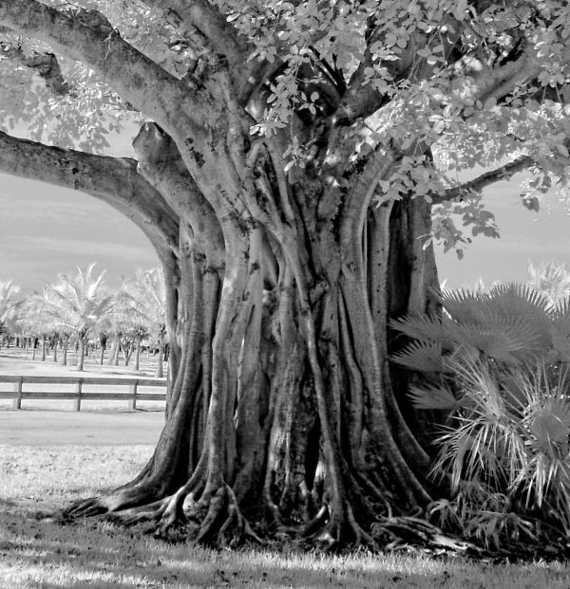
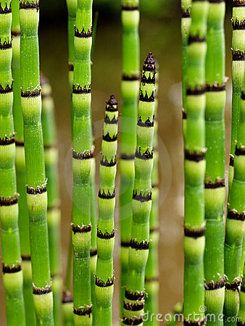
Stems

Slide 36
Stem (Trunk)
– supports branches, leaves, and flowers
– provides way a way to transport materials
– VASCULAR TISSUE is contained for carrying substances to and from roots, leaves, flowers, and fruits
– some are specialized for food storage, protection, photosynthesis, and reproduction

Slide 37
HOMEWORK
Read Section 4.1
Pg. 128, #1 – 7

